Slide 1

Algorithms and Data Structures 1 CS 0445
Fall 2023
Sherif Khattab
ksm73@pitt.edu
(Slides are adapted from Dr. Ramirez’s and Dr. Farnan’s CS1501 slides.)

Slide 2
Announcements
Upcoming Deadlines:
Lab 1: Friday 9/15 @ 11:59 pm
Homework 3: Tuesday 9/19 @ 11:59 pm
Lab 2: Friday 9/22 @ 11:59 pm
Programming Assignment 1: Friday 9/29 @ 11:59 pm
Post-lab exercises are optional
SCI Week is next week!
Professional Development opportunities

Slide 3
Using a Bag
A Bag is a simple ADT, but it can still be useful
Online Shopping cart
Collections of items, power-ups, or resources that a player can collect or use in a game
The words in a document to keep their frequencies
"bag of words" model in Natural Language Processing
Computer network events (e.g., packets of certain types) and their frequencies
used in network traffic analysis

Slide 4
Notes about generic types
ArrayBag<T> is a subtype of ArrayBag<?>.
ArrayBag<Object> is a subtype of ArrayBag<?>
ArrayBag<T> is NOT a subtype of ArrayBag<Object>
All of the above are subtypes of Object
Let’s say that we are designing a method to display an ArrayBag
public static void display(ArrayBag<?> bag)
takes an ArrayBag of any type
public static void display(ArrayBag<Object> bag)
limited to receive ArrayBag<Object>, not ArrayBag<Integer> or ArrayBag<String>, etc.

Slide 5
Notes about generic types
Let’s say that we are designing a method to search for and return an item inside an ArrayBag
public static <T> T search(ArrayBag<T> bag, T target)
using type parameter T helps enforce that the target item type and return type are the same as the type of the items in the ArrayBag
We can call search on an ArrayBag<Integer> and search for an Integer
We cannot call search on ArrayBag<Integer> and search for a String
public static T search(ArrayBag<?> bag, T target)
No enforcement of that type constraint
Would be possible to call search on ArrayBag<Integer> and search for a String

Slide 6
Unchecked Type Casting
The unchecked cast from Object[] to T[] is to make the complier happy when it performs type checking, which happens before type erasure
@SuppressWarnings("unchecked")
T[ ] tempBag = (T[ ]) new Object[desiredCapacity]; // Unchecked cast
bag = tempBag;

Slide 7

Making the ArrayBag Implementation Secure
Practice fail-safe programming by including checks for anticipated errors
Validate input data and arguments to a method
Refine incomplete implementation of ArrayBag to make code more secure by adding the following two data fields

Slide 8
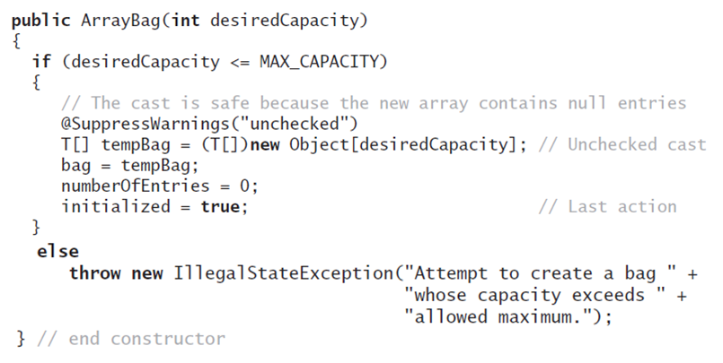
Making the Implementation Secure
Revised constructor

Slide 9
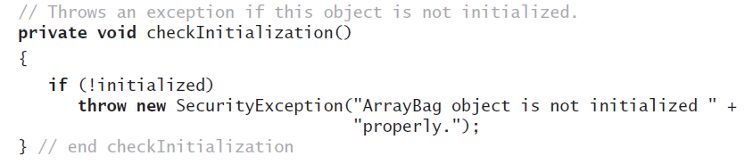
Making the Implementation Secure
Method to check initialization

Slide 10
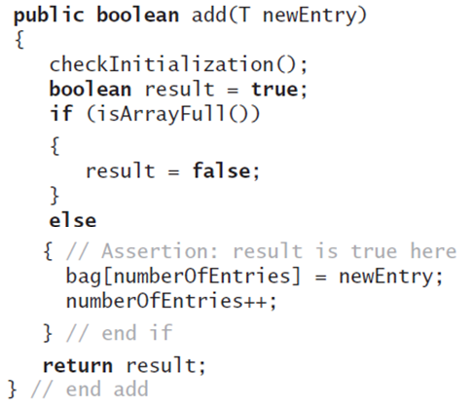
Making the Implementation Secure
Revise the method add

Slide 11
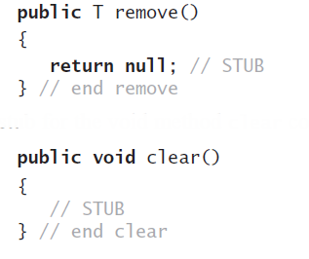
Testing the Core Methods
Method stubs to make the compiler happy

Slide 12
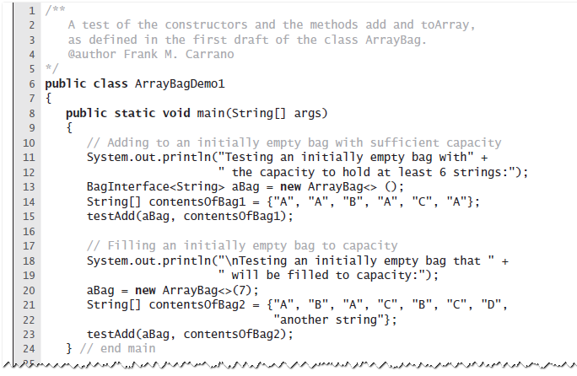
Testing the Core Methods
A program that tests core methods of the class ArrayBag

Slide 13
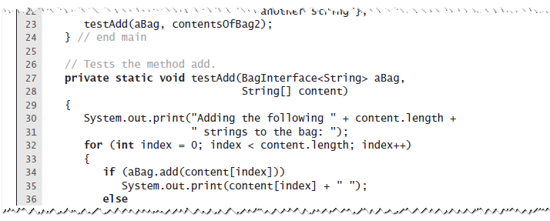
Testing the Core Methods
testAdd method

Slide 14
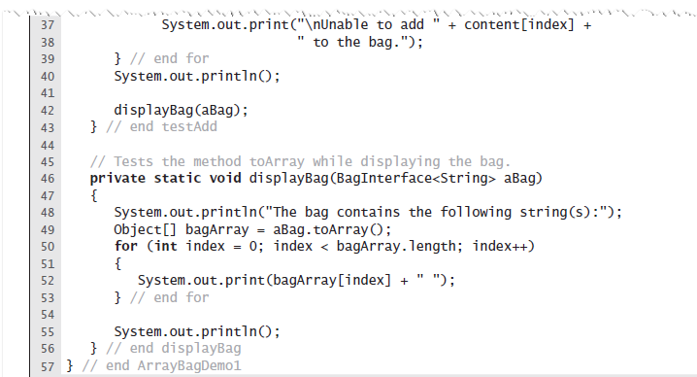
Testing the Core Methods
displayBag method

Slide 15
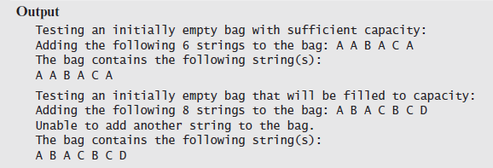
Testing the Core Methods
Expected Output

Slide 16
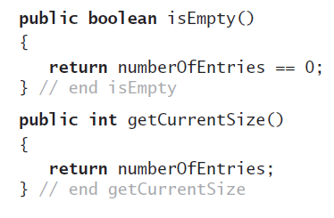
Implementing More Methods
Methods isEmpty and getCurrentSize

Slide 17
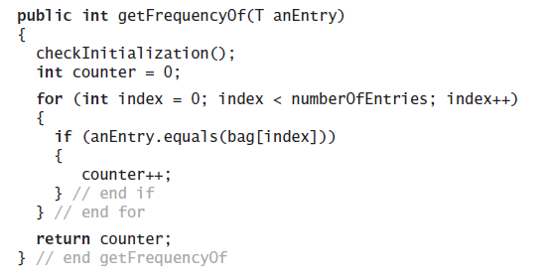
Implementing More Methods
Method getFrequencyOf

Slide 18
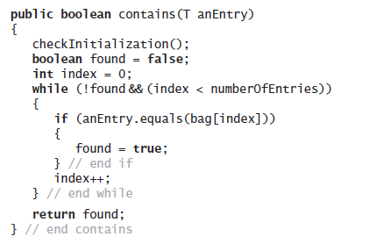
Implementing More Methods
Method contains

Slide 19
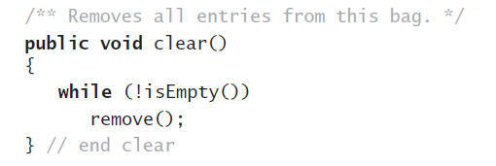
Clearing a bag
The method clear

Slide 20
Incorrect ways to clear a bag
These are some incorrect ways of clearing an ArrayBag object
Incorrect method 1: bag = null;
why is that incorrect?
how to safeguard against that?
make the bag array final
Incorrect method 2:
for(int i=0; i<numberOfEntries; i++)
remove();

Slide 21
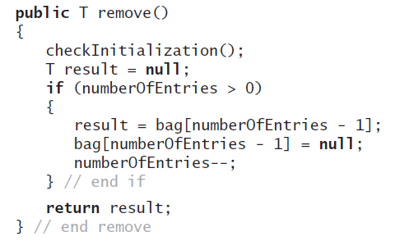
Removing any entry
remove

Slide 22
Removing a specific entry: the algorithm
find the index of an item that equals the item that we want to remove
if not found, return false
if found,
save the found item by result = bag[index]
replace the item by the last item of the array
bag[index] = bag[numberOfEntries-1]
remove the last item in the array
bag[numberOfEntries-1] = null
decrement the logical size of the array
numberOfEntries--

Slide 23
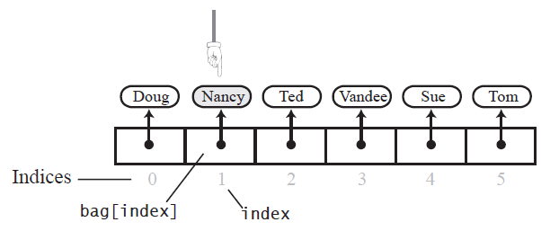
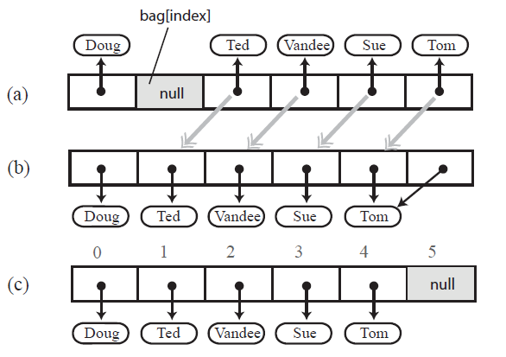
Removing a specific entry
Removing “Nancy”
gap in the array after setting the entry in bag[index] to null
shifting subsequent entries to fill the gap

Slide 24
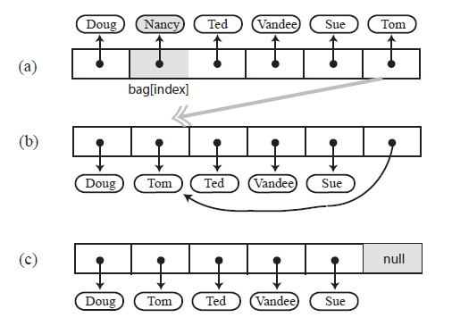
Methods That Remove Entries
Avoiding a gap in the array while removing an entry

Slide 25
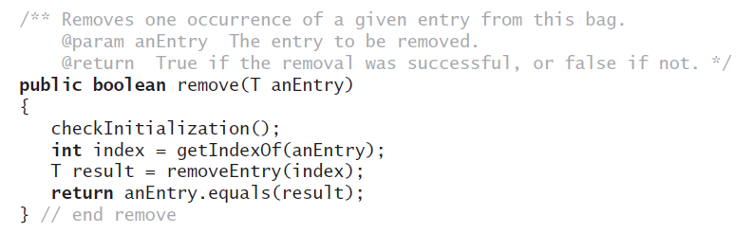
Methods That Remove Entries
The second remove method

Slide 26
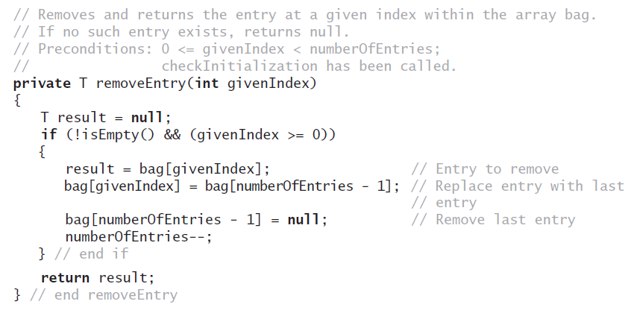
Methods That Remove Entries
The removeEntry method

Slide 27
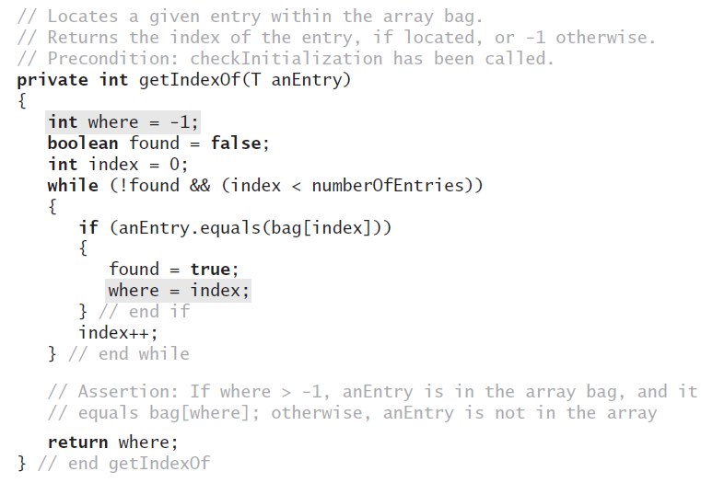
Methods That Remove Entries
Definition for the method getIndexOf

Slide 28
Hints for Assignment 1
CS 0445
Sherif Khattab

Slide 29
Sequences
Sequences appear in many applications
Numbers are sequences of digits
Strings are sequences of characters
Genomes are sequences of nucleotides (A, T, C, G)
…
Some of these sequences may be huge!
We usually use arrays or linked chains to implement Sequences
Some operations may be in-efficient in those implementations, e.g.,
checking if two items X and Y occur next to each other in the sequence
iterating over all occurrences of X followed by Y in the sequence
This assignment investigates an alternative implementation that is potentially more efficient for these operations

Slide 30
2-d array implementation
Let’s implement a sequence using a table structure
and let’s use a 2-dimensional array to implement that table

Slide 31
Some definitions
A sequence is a list of symobls drawn from a specified alphabet
an alphabet is the set of possible symbols that can appear in the sequence
e.g., a decimal number has {0, 1, 2, 3, 4, 5, 6, 7, 8, 9} as its alphabet
e.g., an English sentence has the set of letters and punctuation symbols and white space characters as its alphabet
e.g., a genome has {A, T, C, G} as its alphabet

Slide 32
Example
Let’s take an example sequence to illustrate how this 2-d array structure works
Example sequence: 9875732732
It has 10 digits

Slide 33
Two-dimensional array representation
The 2-d array has 10 rows and 10 columns
Note that 10 is the size of the alphabet {0, 1, 2, 3, 4, 5, 6, 7, 8, 9}
 | 0 | 1 | 2 | 3 | 4 | 5 | 6 | 7 | 8 | 9
0
1
2
3
4
5
6
7
8
9

Slide 34
2-d array representation
Remember that our focus is more on adjacency of digits
digit x occurs before digit y
for each two consecutive digits x and y, we want to record the fact that x is before y in a quickly searchable position
array[x][y]
Since x can appear before y in the sequence multiple times, we will keep track of all such occurrences inside array[x][y]
So, for each two consecutive digits x and y, we add the position of the second digit, y, to array[x][y]

Slide 35
Two-dimensional array representation
9875732732
 | 0 | 1 | 2 | 3 | 4 | 5 | 6 | 7 | 8 | 9
0
1
2
3
4
5
6
7
8
9 |  |  |  |  |  |  |  |  | {1}

Slide 36
Two-dimensional array representation
9875732732
 | 0 | 1 | 2 | 3 | 4 | 5 | 6 | 7 | 8 | 9
0
1
2
3
4
5
6
7
8 |  |  |  |  |  |  |  | {2}
9 |  |  |  |  |  |  |  |  | {1}

Slide 37
Two-dimensional array representation
9875732732
 | 0 | 1 | 2 | 3 | 4 | 5 | 6 | 7 | 8 | 9
0
1
2
3
4
5
6
7 |  |  |  |  |  | {3}
8 |  |  |  |  |  |  |  | {2}
9 |  |  |  |  |  |  |  |  | {1}

Slide 38
Two-dimensional array representation
9875732732
 | 0 | 1 | 2 | 3 | 4 | 5 | 6 | 7 | 8 | 9
0
1
2
3
4
5 |  |  |  |  |  |  |  | {4}
6
7 |  |  |  |  |  | {3}
8 |  |  |  |  |  |  |  | {2}
9 |  |  |  |  |  |  |  |  | {1}

Slide 39
Two-dimensional array representation
9875732732
 | 0 | 1 | 2 | 3 | 4 | 5 | 6 | 7 | 8 | 9
0
1
2
3
4
5 |  |  |  |  |  |  |  | {4}
6
7 |  |  |  | {5} |  | {3}
8 |  |  |  |  |  |  |  | {2}
9 |  |  |  |  |  |  |  |  | {1}

Slide 40
Two-dimensional array representation
9875732732
 | 0 | 1 | 2 | 3 | 4 | 5 | 6 | 7 | 8 | 9
0
1
2
3 |  |  | {6}
4
5 |  |  |  |  |  |  |  | {4}
6
7 |  |  |  | {5} |  | {3}
8 |  |  |  |  |  |  |  | {2}
9 |  |  |  |  |  |  |  |  | {1}

Slide 41
Two-dimensional array representation
9875732732
 | 0 | 1 | 2 | 3 | 4 | 5 | 6 | 7 | 8 | 9
0
1
2 |  |  |  |  |  |  |  | {7}
3 |  |  | {6}
4
5 |  |  |  |  |  |  |  | {4}
6
7 |  |  |  | {5, 8} |  | {3}
8 |  |  |  |  |  |  |  | {2}
9 |  |  |  |  |  |  |  |  | {1}

Slide 42
Two-dimensional array representation
9875732732
 | 0 | 1 | 2 | 3 | 4 | 5 | 6 | 7 | 8 | 9
0
1
2 |  |  |  |  |  |  |  | {7}
3 |  |  | {6}
4
5 |  |  |  |  |  |  |  | {4}
6
7 |  |  |  | {5, 8} |  | {3}
8 |  |  |  |  |  |  |  | {2}
9 |  |  |  |  |  |  |  |  | {1}

Slide 43
Two-dimensional array representation
9875732732
 | 0 | 1 | 2 | 3 | 4 | 5 | 6 | 7 | 8 | 9
0
1
2 |  |  |  |  |  |  |  | {7}
3 |  |  | {6, 9}
4
5 |  |  |  |  |  |  |  | {4}
6
7 |  |  |  | {5, 8} |  | {3}
8 |  |  |  |  |  |  |  | {2}
9 |  |  |  |  |  |  |  |  | {1}

